Slide 1
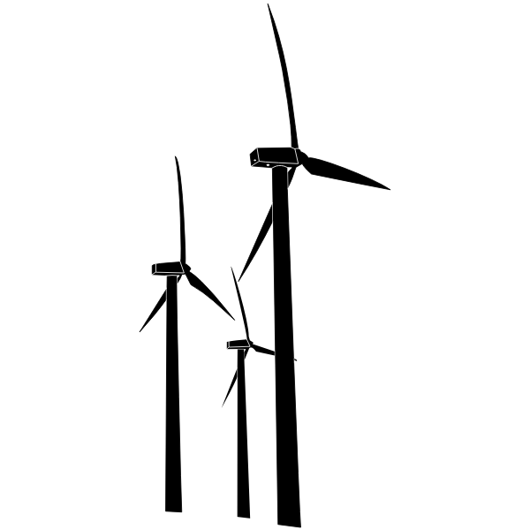


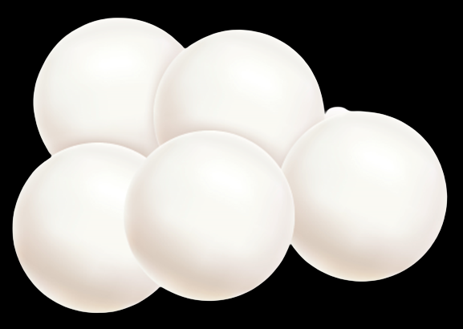
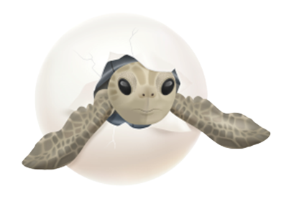
Ground Vibration Simulator for Investigating Effects on the Development of Turtle Eggs
SYSC 4907 – Group 44
Fourth Year Engineering Project
In collaboration with
The Davy Lab, Department of Biology, Carleton University

Slide 2
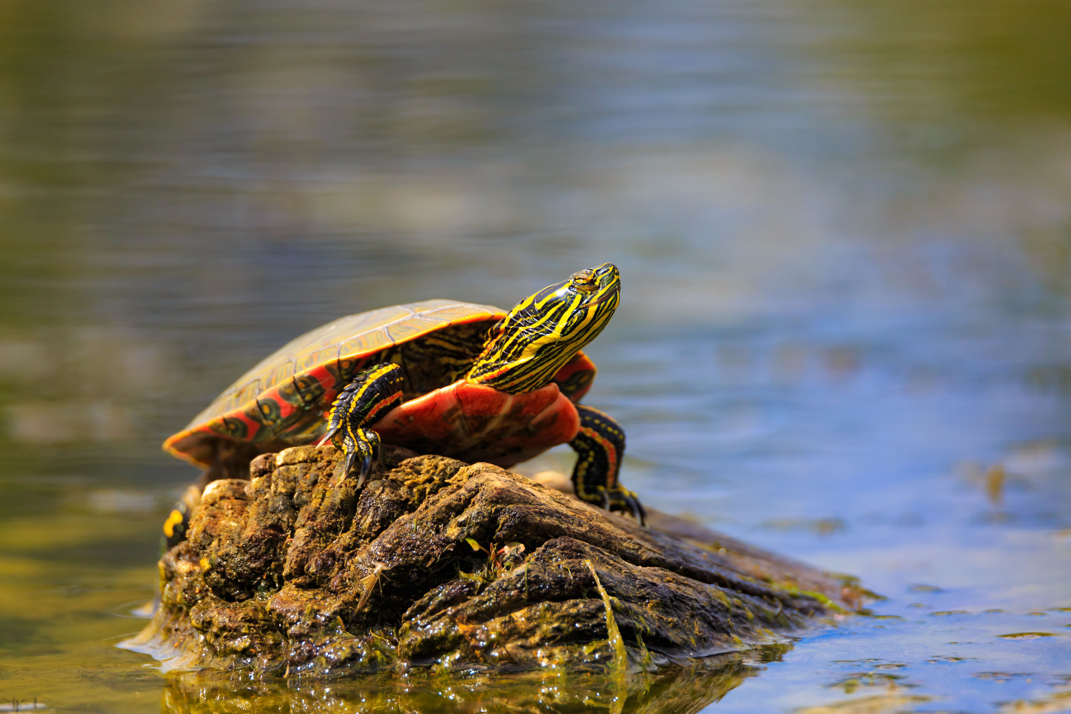

Notes:
Turtles spend most of their lives in bodies of water. In Ontario, these habitats include lakes, ponds, rivers, marshes, and bogs.

Slide 3
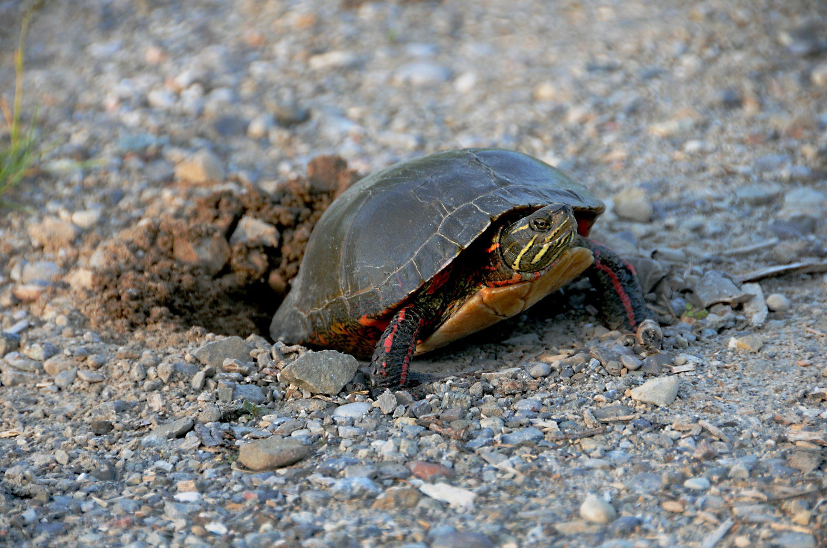
Notes:
However, when it comes time to lay eggs, turtles seek higher ground and bury their eggs in loose, sandy substrate.

Slide 4
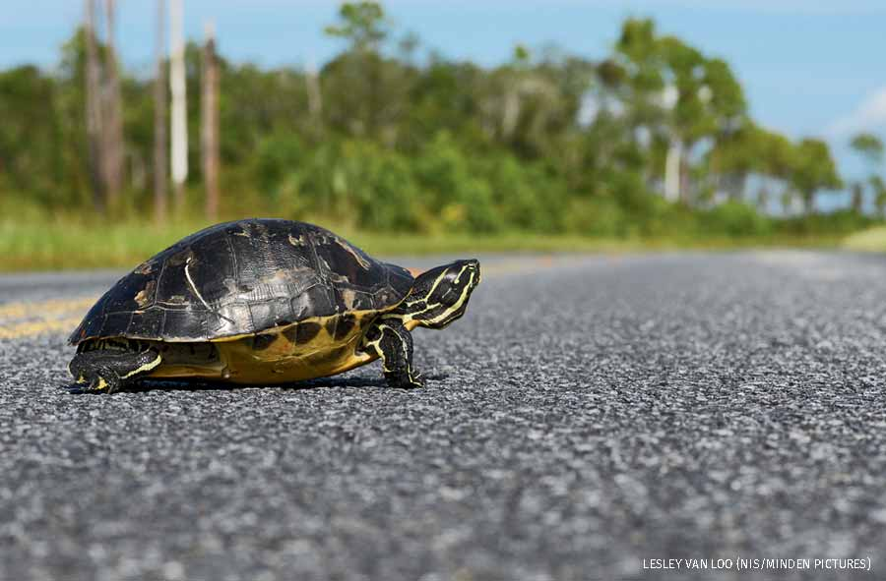
Notes:
and power generation sites common locations to find turtle nesting areas. Research on the effects of ground vibrations from these sites is lacking.

Slide 5
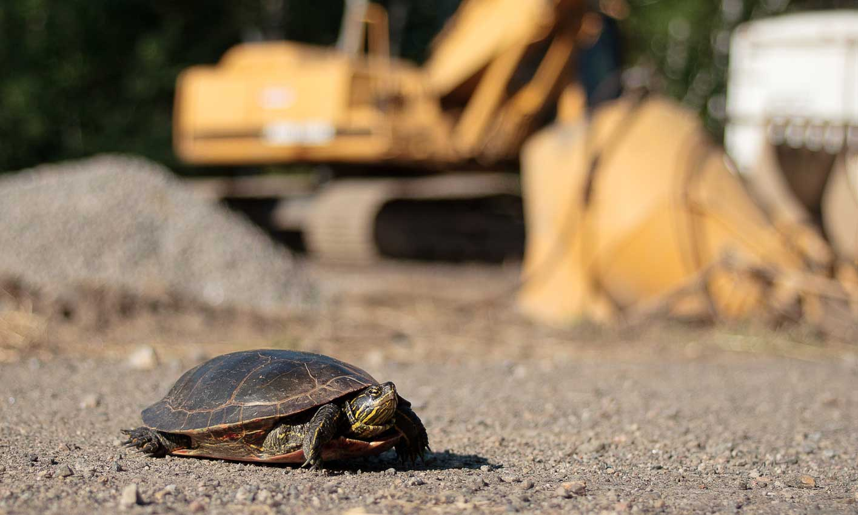
Notes:
and power generation sites common locations to find turtle nesting areas. Research on the effects of ground vibrations from these sites is lacking.

Slide 6

Notes:
and power generation sites common locations to find turtle nesting areas. Research on the effects of ground vibrations from these sites is lacking.

Slide 7
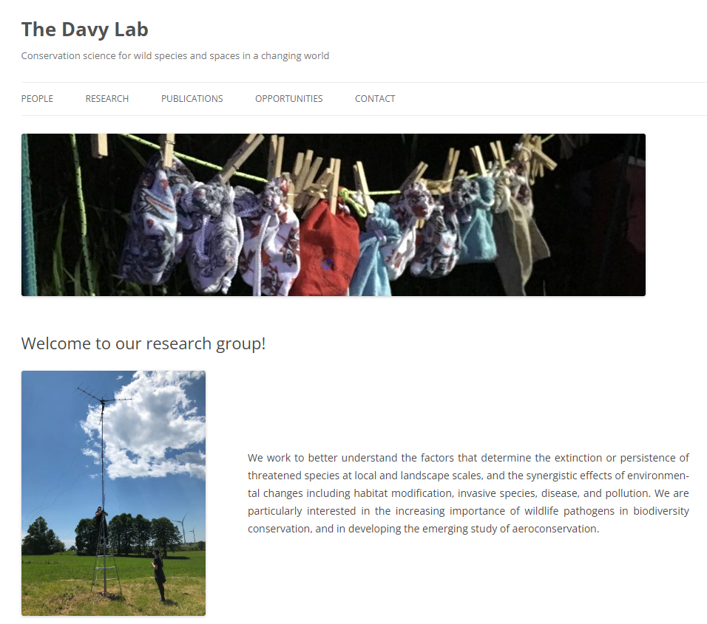
Notes:
The Davy Lab at Carleton University is a research group that specializes in conservation of turtles local to Southern and Eastern Ontario. They want to find out what effects ground vibrations from human activity have on the development of turtle eggs.

Slide 8
Notes:
During turtles’ embryonic development, baby turtles communicate with one another in the nest through mechanical vibrations [1]. This communication has been shown to affect and even initiate hatching among some species of turtles. The Davy Lab is investigating whether ground vibrations from human activity could have a similar effect on turtle egg development, and whether these effects are detrimental to local turtles.

Slide 9
Notes:
This communication has been shown to affect and even initiate hatching among some species of turtles. The Davy Lab is investigating whether ground vibrations from human activity could have detrimental effects on the embryonic development of local turtle species.

Slide 10
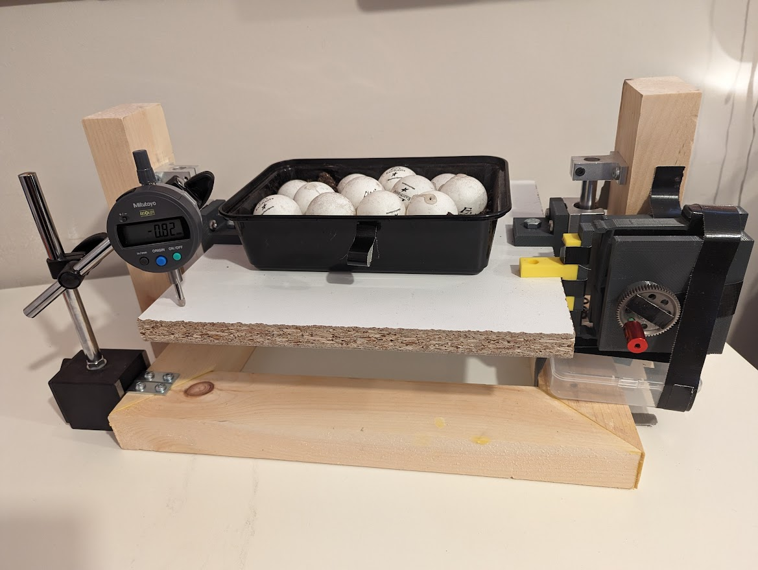
0.02 – 0.04 mm
6 – 26 Hz
Notes:
Since observing turtle nests in the wild is extremely time consuming and difficult, group 44 developed a shake table device that can simulate ground vibrations felt near roadways and highways in a controlled, lab environment.

Slide 11
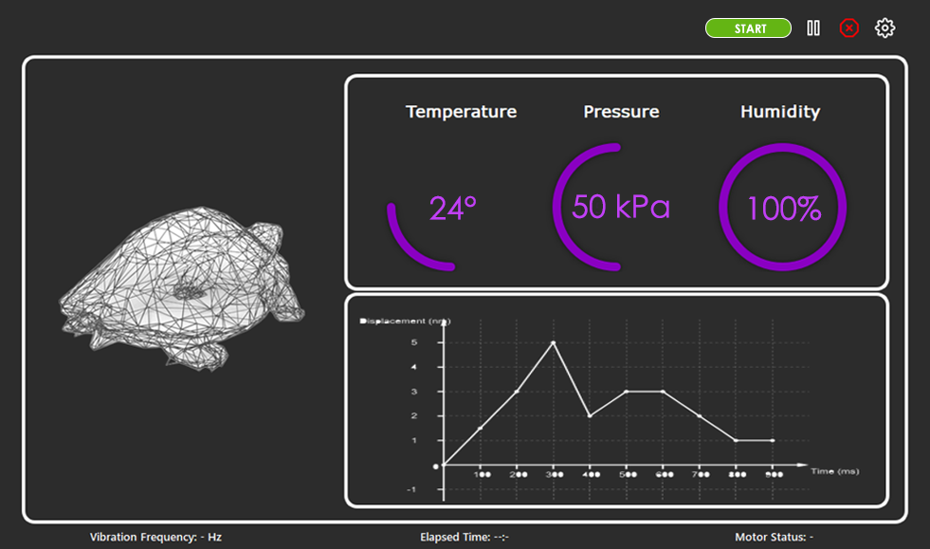
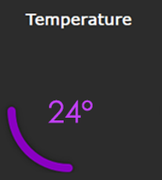
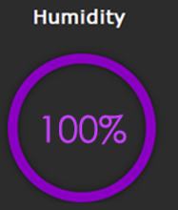
Notes:
A user interface allows groups like the Davy lab to monitor conditions during the experiment.

Slide 12
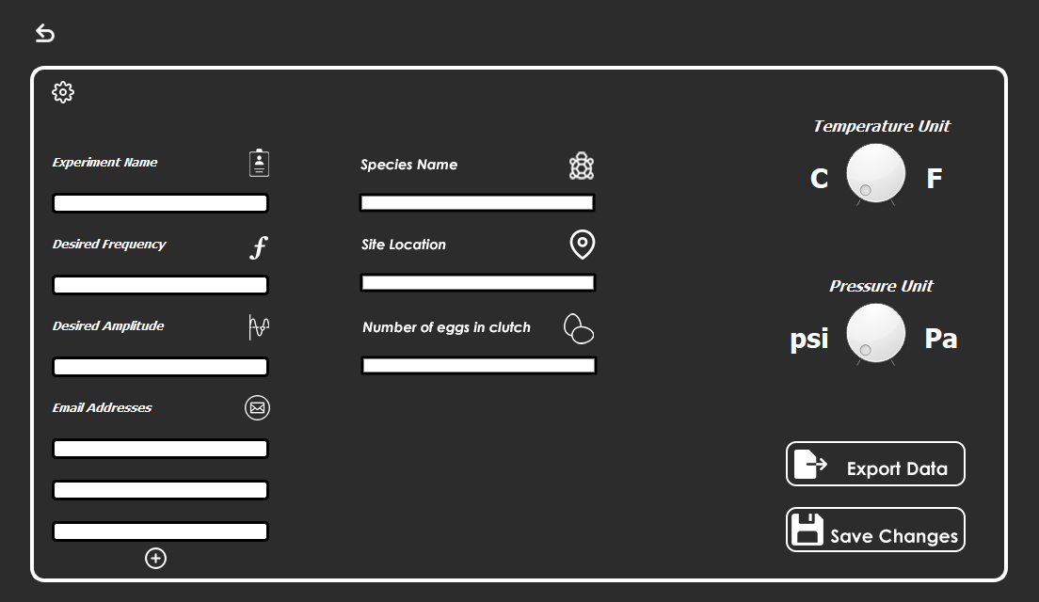
Notes:
With customizable settings, the device allows the user to study various vibration effects on turtle egg development.

Slide 13
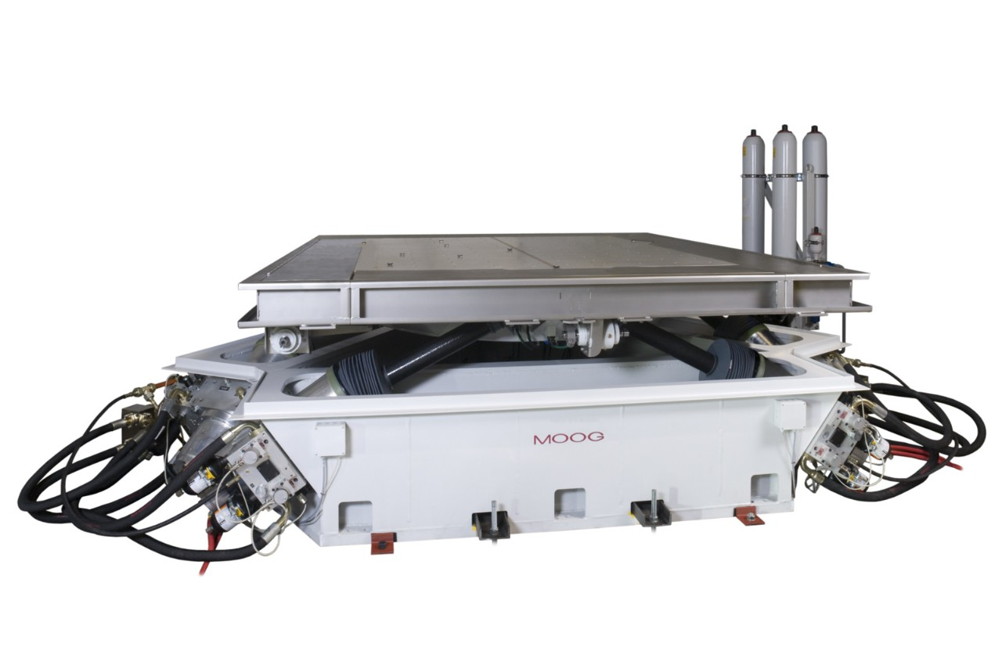
$6000+

Slide 14
< $1000
Notes:
Since observing turtle nests in the wild is extremely time consuming and difficult, group 44 developed a shake table device that can simulate ground vibrations felt near roadways and highways in a controlled, lab environment.

Slide 15
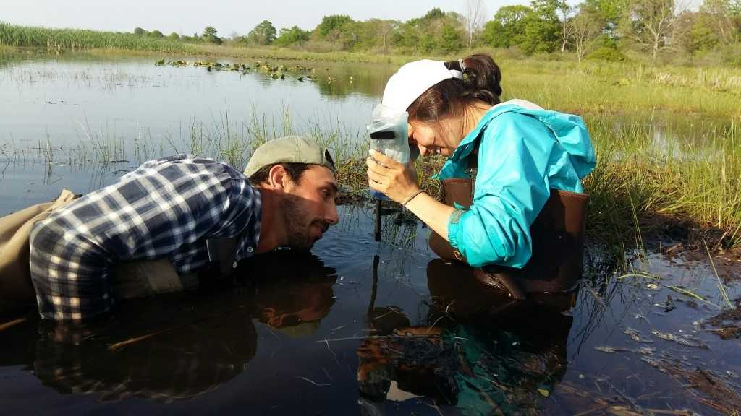
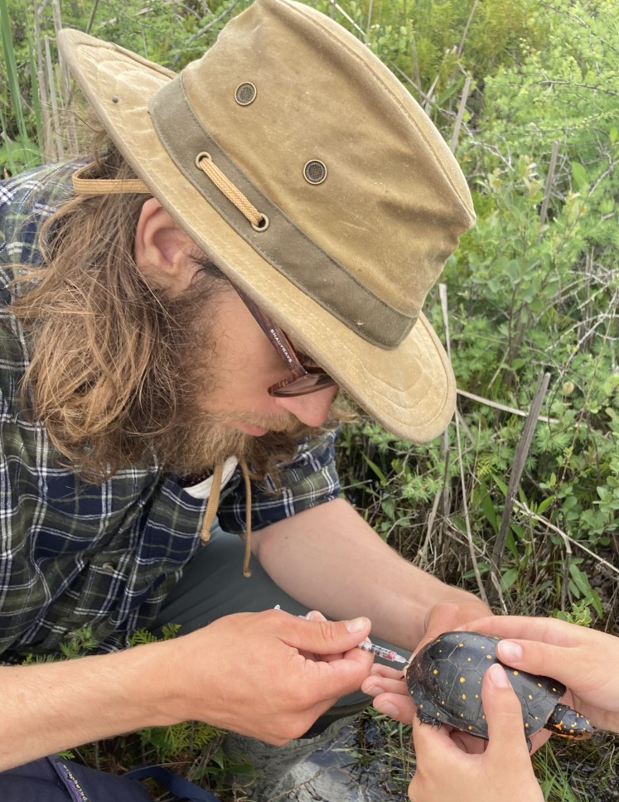
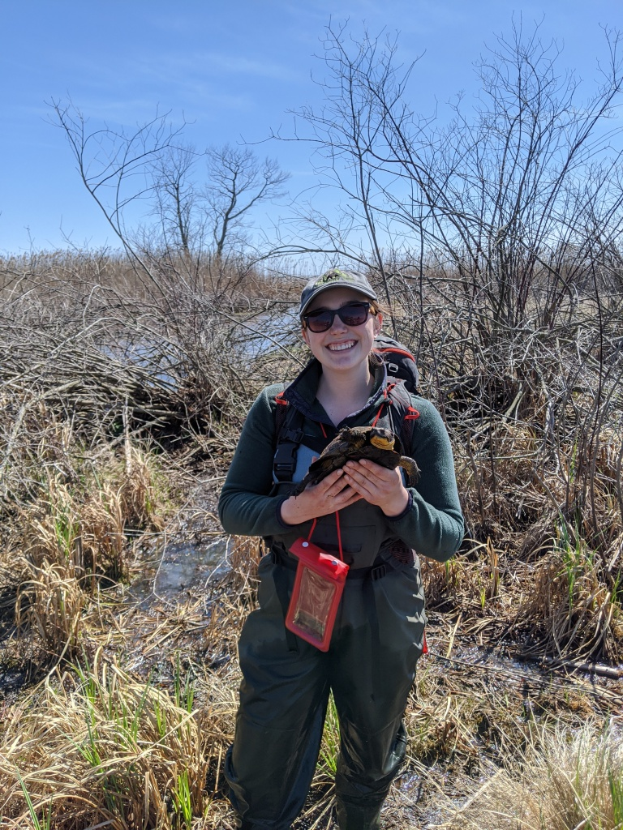
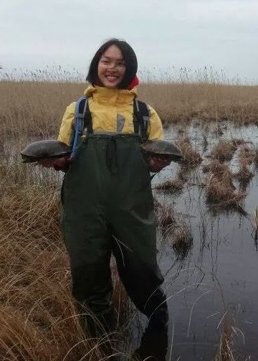

Slide 16
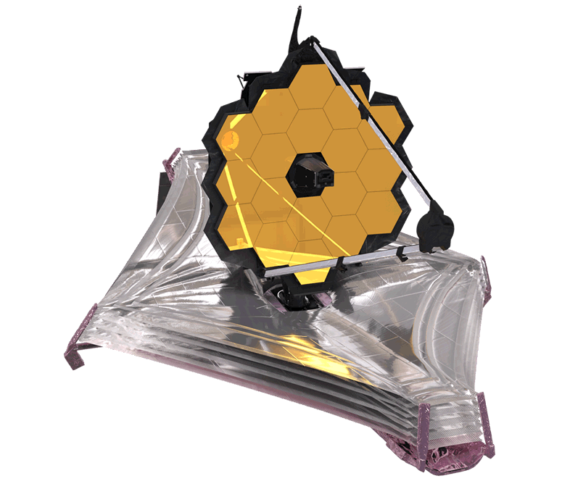
Inspiration: James Webb Space Telescope

Slide 17

Ground Vibration Simulator
Available: https://github.com/bienemeia/SYSC4907_Group44_GroundVibrationSimulator.git

